Slide 1
MARAD Title VI Pre-Award Review

Slide 2
Title VI
No person in the United States shall, on the ground of race, color, or national origin, be excluded from participation in, be denied the benefits of, or be subjected to discrimination under any program or activity receiving Federal financial assistance.
42 U.S.C. § 2000d

Slide 3
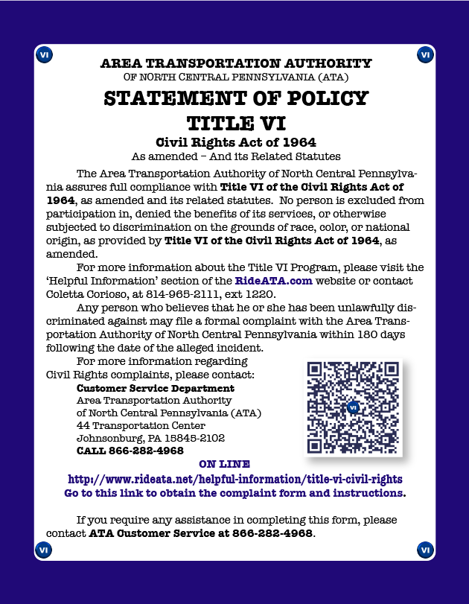
What is covered under Title VI?
Coverage extends to entire program or activity, i.e., to all parts of a recipient's operations, even if only one part of recipient operation receives the Federal assistance.*
.
*49 CFR Section 21.7(a)

Slide 4
Title VI Pre-Award Review

Slide 5
Notification to Beneficiaries and Participants
All recipients are required to submit the following information to MARAD OCR prior to grant execution:
A copy of the recipient’s public notice informing the public of their rights under Title VI/ADA*
A weblink on the recipient’s website where it has posted a copy of the public notices that are accessible to the public
A description of where the recipient has posted this notice in facilities accessible by the public (if applicable)
Notes:
-See Template Pages 1

Slide 6
Complaint Procedures
All recipients are required to submit the following information to MARAD OCR prior to grant execution:
A copy of the recipient’s Title VI/ADA complaint procedures, which must include, but are not limited to, instructions to the public on how to file a Title VI/ADA complaint*
A designated employee for coordinating Title VI and ADA complaint investigations
A weblink on the recipient’s website where it has posted a copy of the Complaint Form and Procedures
A copy of the recipient’s Title VI/ADA Complaint Form**
Notes:
Complaint Procedure Template pg 3-5
Complaint Form Template pg 5

Slide 7
Complaint Procedures
Examples:
Port Authority NY NJ
Policy statement, complaint form, and complaint procedures on page
Translation of Vital Documents
Accessible from home page
Complaint POC
Port of Seattle
Policy statement, complaint form on page
Accessible from the home page in “3 clicks”
No translation of vital documents, no complaint procedures
Complaint POC

Slide 8
External Investigations, Complaints, & Reviews
Recipients must provide:
A description of any external lawsuits, investigations, or complaints alleging discrimination on the basis of race, color, national origin (including limited English proficiency), or disability filed against the recipient (or any of its proposed subrecipients, if applicable) within five years of the date of the application,
Recipients must also provide explanation of the status or outcome of each matter.

Slide 9
External Investigations, Complaints, & Reviews
Recipients must also provide:
A description of any civil rights compliance reviews that are ongoing, or have been completed within the last five years, by MARAD, or other state, local, or federal agencies. This description must discuss*:
Any deficiencies identified by past reviews
Corrective actions taken or that are underway to address the deficiencies identified
Copies of any reports from compliance reviews conducted by another agency
Notes:
- Template page 8 -MARAD is authorized to request this information under 49 CFR 21.9
- MARAD is not interested in internal HR matters. We are interested in external complaints, audits, and investigations, from the public or by other state, local, or federal agencies
This information will not be used against the recipient. It will not result in termination of a grant, but provides a snapshot of the recipient’s compliance history and will be used to help direct MARAD technical assistance and guidance
If past recipient of MARAD funds, will also be used to assess past efforts at compliance

Slide 10
Planning and Advisory Board Membership
A table depicting the membership of any non-elected committees and councils, the membership of which is selected by the recipient, broken down by race
A description of the process the agency uses to encourage the participation of minorities on such committees

Slide 11
Legacy Infrastructure
A plan to address any legacy infrastructure or facilities that are not compliant with ADA standards
MARAD is collecting this for informational purposes only to:
Assess the scope of legacy infrastructure accessibility challenges
Ensure that future improvements to any legacy infrastructure address accessibility issues
To evaluate the accessibility of ports for persons with disabilities
Support development of future initiatives, like FTA’s All Stations Accessibility Program, to address barriers to accessibility in the maritime industry

Slide 12
Compliance Monitoring
If a recipient intends to or is presently providing Federal funding to another entity, the recipient is responsible for monitoring the entity’s (i.e., Sub-Grantee of Federal funding) compliance with DOT non-discrimination requirements. This requirement also extends to recipients with tenants, who are responsible for ensuring that port tenants do not discriminate in any of their programs or activities.

Slide 13
Compliance Monitoring
Recipients must provide:
Documentation that it includes the USDOT Standard Title VI Assurances and Non-Discrimination Provisions (DOT Order 1050.2A) in all recipient contracts, sub-recipient agreements, and tenant agreements*
A description of how the recipient will periodically evaluate and monitor the programs and activities of sub-recipients, tenants, or any other pass-through entities for nondiscriminatory treatment and potential impact on communities on the basis of race, color, national origin (including Limited English proficiency), and disability.
Notes:
*should be in grant agreement, can provide if needed
• The development of project or activity specific oversight procedures, schedules, tools, or documentation requirements
• Procedures of identifying and correcting program or performance deficiencies
• Technical assistance or training on grant requirements, including federal non-discrimination requirements
• Regular communication
• Routine site visits

Slide 14
Community Participation Plans

Slide 15
Community Participation Plans
Recipients receiving awards under the PIDP and Marine Highway Programs are required to develop a Community Participation Plan.
This plan should describe the recipient’s strategy for incorporating community engagement into its routine operations
This plan will inform project specific community engagement but should be applied to all port project and activities with the potential to interface with or impact the surrounding community.
Plans will vary based on community needs, recipient size, and the types of projects and activities the port engages in.

Slide 16
Community Participation Plans
While the size and scope of Community Participation Plans will vary, the Department considers the following elements to be key components of an effective Community Participation Pan
Identification of affected populations
Targeted Outreach
Meaningful communication
Diverse communication
Meaningful Participation
Recordkeeping
Reported Outcomes
Comprehensive engagement

Slide 17
Community Participation Plan
Recipient plans should include a description of
The recipient’s practices for obtaining proactive and meaningful public participation ensure that the community is adequately informed about how the recipient’s programs, projects, and other activities will affect them
How the recipient will obtain proactive and meaningful public participation that ensures that diverse views are heard and considered throughout all stages of consultation, planning, and decision-making processes
Key community stakeholders, including advocacy groups, community-based organizations, and other advisory bodies

Slide 18
Community Participation Plan
Additional Guidance on Community Participation Plans:
Promising Practices for Meaningful Public Involvement in Transportation Decision-Making
DOT Order 1000.12C (Chapter II Section 4 “Community Participation Plan”)
Environmental Justice Policy Guidance for Federal Transit Administration Recipients
Notes:
-Sample Title VI plans with Community Participation and Language Access Plans will be shared after this call
- A slide deck on CPP we developed in house will be shared as well.

Slide 19
Limited English Proficiency
(LEP)

Slide 20
Language Access Plan: Four Factor Analysis
DOT Recipients are required to take reasonable steps to ensure meaningful access to benefits, services, information, and other important portions of their programs and activities for individuals who are limited-English proficient (LEP).
The number/proportion of LEP persons eligible for and likely to be encountered by a program or service of the recipient or grantee
The nature and importance of the program, activity, or service provided by the recipient to people’s lives
Four-Factor
Analysis
The frequency with which LEP individuals come in contact with the program
The resources available to the recipient and costs

Slide 21
Language Access Plan
Recipients have considerable flexibility in developing a Language Assistance Plan, or LEP Plan.
An LEP Plan shall, at a minimum:
Include the results of the Four Factor Analysis, including a description of the LEP population(s) served;
Describe how the recipient provides language assistance services by language;
Describe how the recipient provides notice to LEP persons about the availability of language assistance;
Describe how the recipient monitors, evaluates and updates the language access plan; and
Describe how the recipient trains employees to provide timely and reasonable language assistance to LEP populations.
Notes:
-vital document translation and safe harbor

Slide 22
Equity Analysis

Slide 23
Pre-Award Reviews: Equity Analysis
49 CFR Section 21.5(b)(3) requires recipients to complete a Title VI Equity Analysis during the planning stage of a project to ensure that :
The location was selected without regard to race, color, or national origin
The project will not result in a disparate impact on the surrounding community on the basis race, color, or national origin (including Limited English Proficiency).
The applicant utilized its Community Participation Plan to gather community input sufficient to evaluate project impact

Slide 24
Pre-Award Reviews: Equity Analysis
If a grant applicant determines that their project was sited in a discriminatory manner or will result in a disparate impact:
The applicant must provide a substantial legitimate justification for selecting that location
The applicant must also demonstrate that there are no alternative locations that would result in less of a disparate impact
Notes:
This is a fairly old copy of Title VI assurances, and they belong to FAA. Finding/creating a good sample and publishing online at MARAD would be a great way to highlight MARAD OCR. Update link to documents.

Slide 25
Plan Development and Submission
Title VI Program Plan must be completed prior to execution
Once submitted, MARAD has 30 days to review and approve the plan or return to the recipient with comments
If MARAD returns the plan the recipient is granted an additional 30 days to make the requested changes

Slide 26
Plan Development and Submission
For technical assistance please contact gregory.danis@dot.gov
Completed plans should be submitted to civilrights.marad@dot.gov

